Slide 1



Slide 2


Slide 3


Slide 4
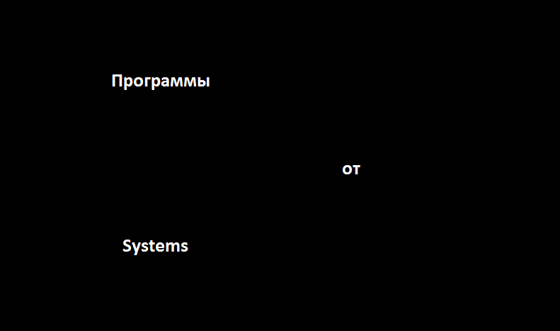

Slide 5
Systems

